Slide 1



Music Store Management System: Customer & Sales Insights

Slide 2



About me
About me
Sai Vamshi Burugu
(B.E - 2023 )
I’m an aspiring Data Scientist who enjoys exploring data and solving real-world problems. I’ve always wanted to contribute to the rapidly evolving field of AI and Machine Learning.
With nearly 2 years of experience at TCS, I’m now focused on building my expertise in data science and working towards creating innovative solutions.
https://github.com/SaiVamshiBurugu
https://www.linkedin.com/in/saivamshiburugu/

Slide 3

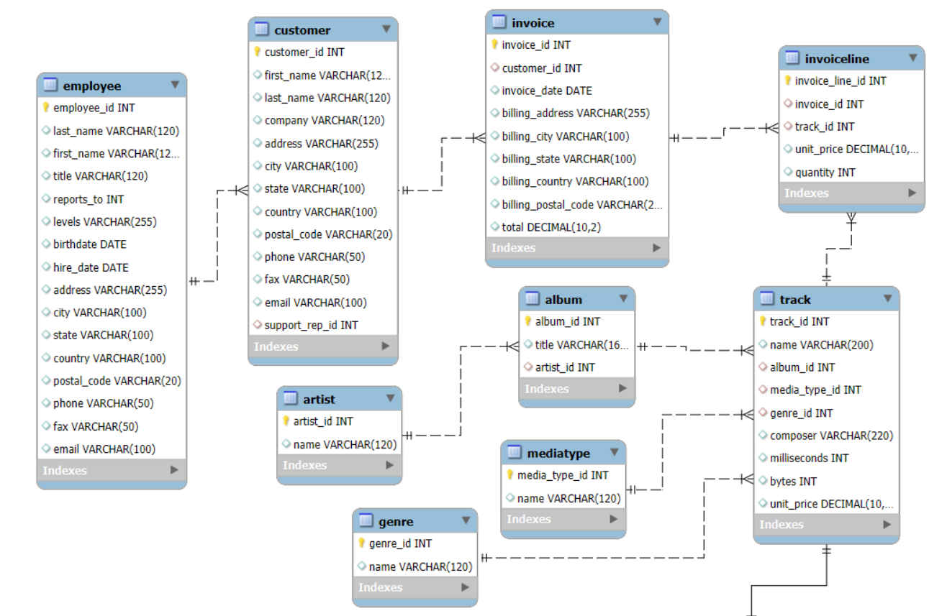
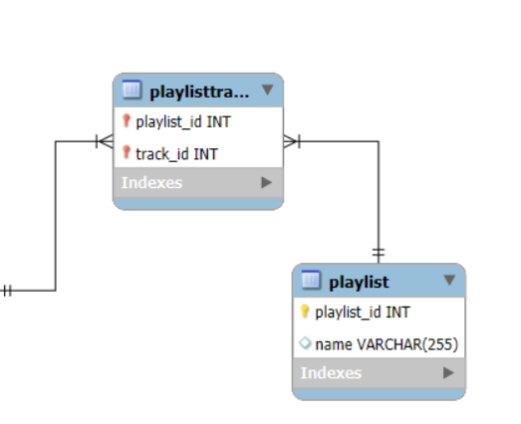

Entity-Relationship diagram

Slide 4
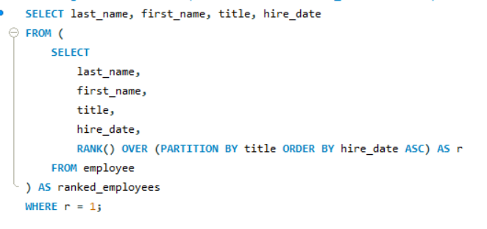
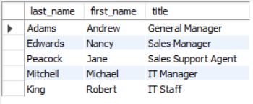
1. Who is the senior most employee based on job title?

Slide 5
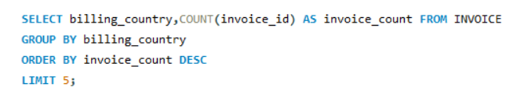
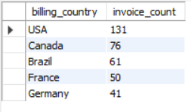

2. Which countries have the most Invoices?

Slide 6
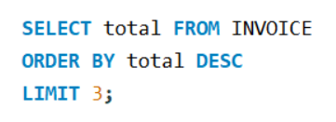

3. What are the top 3 values of total invoice?

Slide 7
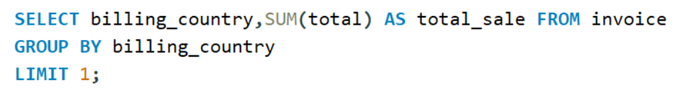


4. Which city has the best customers? - We would like to throw a promotional Music Festival in the city we made the most money. Write a query that returns one city that has the highest sum of invoice totals. Return both the city name & sum of all invoice totals.

Slide 8
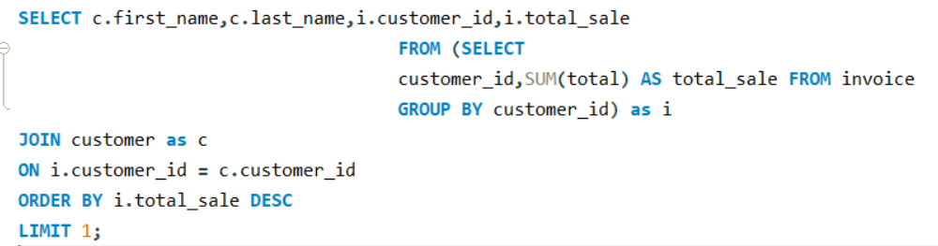

5. Who is the best customer? - The customer who has spent the most money will be declared the best customer. Write a query that returns the person who has spent the most money.

Slide 9
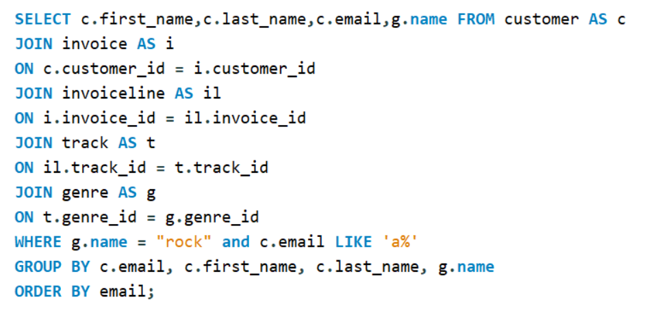
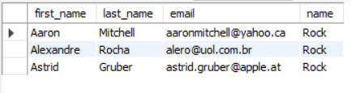
6. Write a query to return the email, first name, last name, & Genre of all Rock Music listeners. Return your list ordered alphabetically by email starting with A.

Slide 10
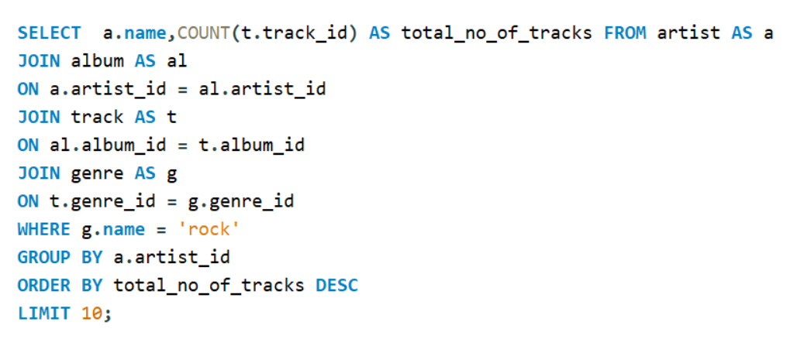
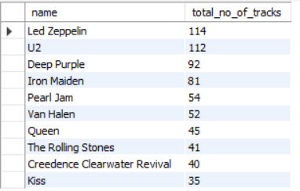

7. Let's invite the artists who have written the most rock music in our dataset. Write a query that returns the Artist name and total track count of the top 10 rock bands.

Slide 11
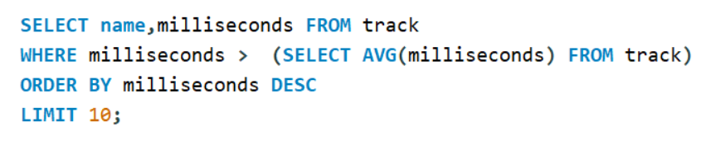
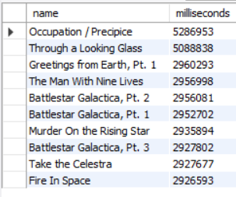

8. Return all the track names that have a song length longer than the average song length.- Return the Name and Milliseconds for each track. Order by the song length, with the longest songs listed first

Slide 12
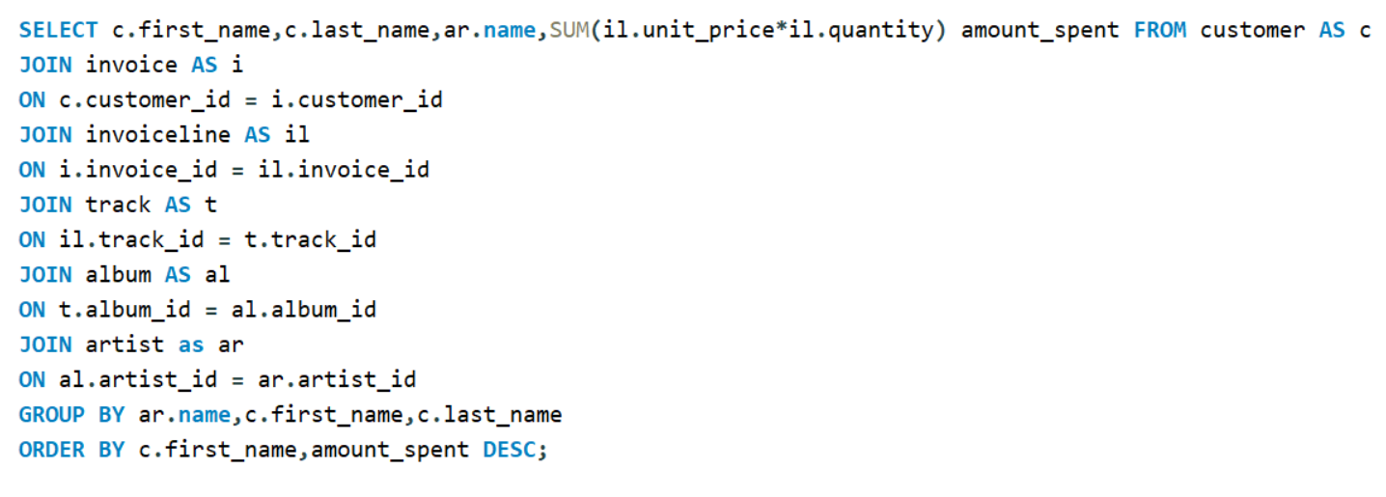
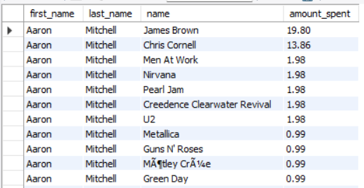
9. Find how much amount is spent by each customer on artists? Write a query to return customer name, artist name and total spent .

Slide 13
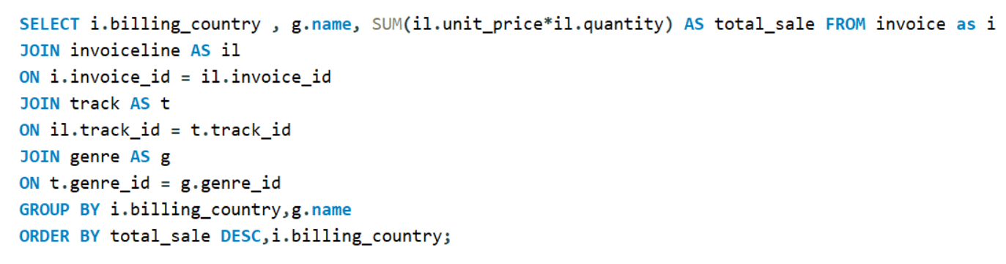
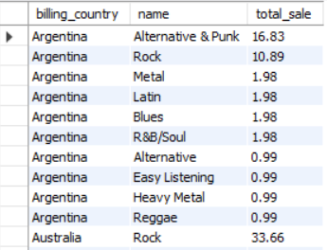
10. We want to find out the most popular music Genre for each country.
We determine the most popular genre as the genre with the highest amount of purchases. Write a query that returns each country along with the top Genre.

Slide 14
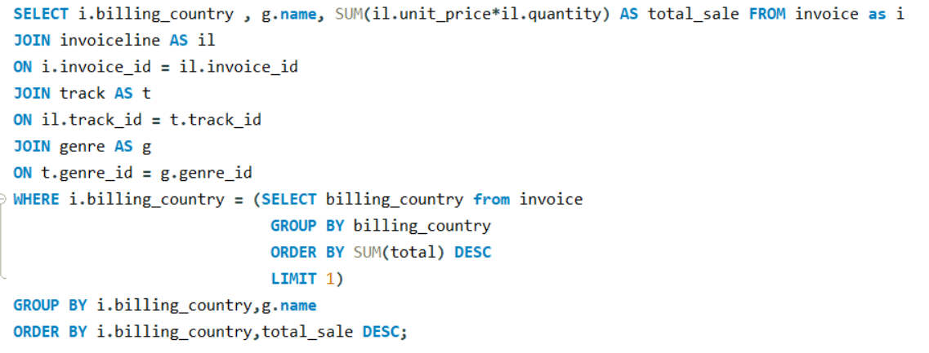
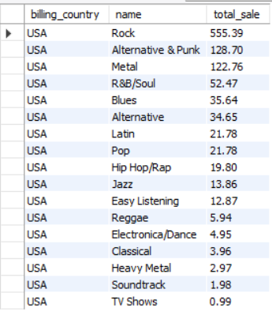
10. b) For countries where the maximum number of purchases is shared, return
all Genres.

Slide 15
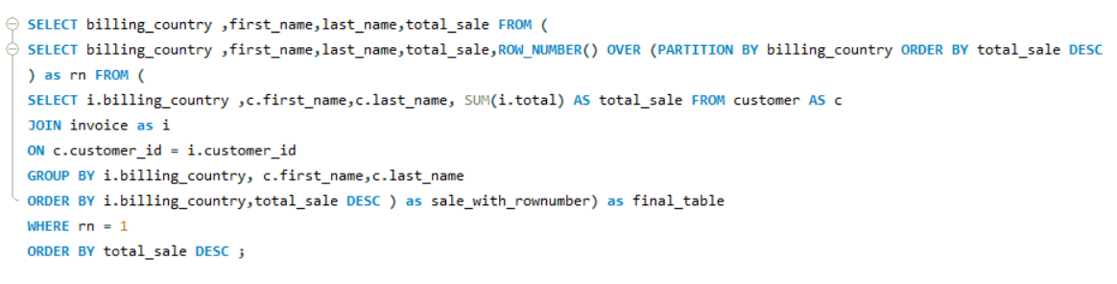

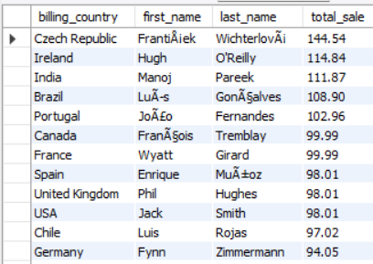
11. a) Write a query that determines the customer that has spent the most on music for each country.

Slide 16
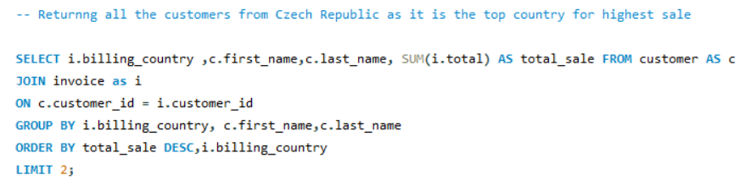

11. b) Write a query that returns the country along with the top customer and how much they spent.

Slide 17
Key Insights
🧑‍💼 Employee Insights :
Adams is identified as the most experienced employee in the store.
🌍 Sales by Country :
The United States (USA) has the highest number of invoices, indicating a large customer base.
The total revenue generated from the USA amounts to $1,040.49.
František Wichterlová from the Czech Republic is the top customer, spending a total of $144.54.
The highest single purchase recorded is $23.76.
🎸 Music & Genre Insights :
Within the Rock genre, Led Zeppelin has the highest number of tracks (114).
The track “Occupation/Precipice” is the longest in the store’s collection.
The combination of USA customers and the Rock genre results in the highest overall sales.
💰 Country-Level Spending Highlight :
Czech Republic stands out for having the top spender, František Wichterlová, contributing the most revenue from that region.

Slide 18
Challenges :
1. Data Quality Issues :
Some names and special characters (like “František Wichterlová”) were not properly encoded.
2. Data Integration Difficulties :
Joining multiple tables (Customer, Invoice, Track, Album, Artist) required careful foreign key mapping.
3. Data Quantity Issues :
Some tables have too many data points , where the import wizard was unable to handle so i have to load it manually.

Slide 19

Conclusion :
The analysis shows that Adams is the most experienced employee.
Most customers are from the USA, which also has the highest total revenue of $1040.49. Specifically rock music has the highest sales, showing that American listeners greatly enjoy Rock music.
The highest single purchase is $23.76, and the Star Customer is František Wichterlová from the Czech Republic, with $144.54 spent.
Led Zeppelin has the most no of tracks.

Slide 20


Slide 21

THANK YOU

